Slide 1
Hourly PM2.5 Forecasting & Unhealthy-Air Warning for Pakistani Cities
Team Name: Khubsoorat Shklein] | [Track: Air Quality]

Slide 2
Problem Statement
THE PROBLEM
1
Who is affected?
Cities like Lahore and Karachi suffer unhealthy PM2.5 spikes, but residents and officials get little advance warning. Sensor data is scattered and noisy, and there is no simple tool that forecasts the next hours with a stated uncertainty range.
[Residents of Lahore, Karachi, Islamabad, Peshawar]
2
Why does it matter?
[PM2.5 drives respiratory illness; smog peaks hit hardest in winter]
3
Our goal
Forecast PM2.5 with uncertainty and explain it with cited sources

Slide 3
Dataset Declaration
409K
Dataset name | Pakistan hourly PM2.5 + weather (4 cities)
Source / link | OpenAQ v3 API (openaq.org) + Open-Meteo archive API (open-meteo.com)
Size | [500K] (500,211 total: 331,731 PM2.5 + 168,480 weather)
Time period | Jan 2022 – Oct 2026
Format & license | Parquet → DuckDB; CC-BY-4.0 (per manifest.csv)
Key features / target | Target: pm25_ugm3. Lags, rolling stats, hour/season, 8 weather variables
[500K]
Rows / records
[27]
Columns / features
[20 MB]
Dataset size

Slide 4
Pipeline Used
1
2
3
4
5
Data Collection
Data Cleaning
Analysis / EDA
Modeling
Dashboard / App
OpenAQ + Open-Meteo APIs
UTC, dedupe, range checks
Lags, rolling, seasonal features
LightGBM + CatBoost quantiles
FastAPI + React, hourly Prefect
Raw sensor + weather data in -> cited PM2.5 forecasts with uncertainty bands out

Slide 5
Pipeline Details & Tools
Stage | Tools / Libraries | What we did
Collection | requests, OpenAQ v3, Open-Meteo, Parquet | Paginated, rate-limited fetch with SHA-256 manifest for reproducibility
Preprocessing | Pandas, DuckDB | Standardised to UTC, deduped, flagged outliers, and logged every decision
Analysis / EDA | DuckDB SQL | Built 27 columns: lags, shifted rolling stats, time and weather features, no leakage
Modeling | LightGBM, CatBoost, scikit-learn | Median + 80% interval models, averaged; time-based split vs persistence baseline
Dashboard / App | FastAPI, React, Prefect, ChromaDB | Hourly flow refreshes forecasts; RAG agent answers with citations

Slide 6
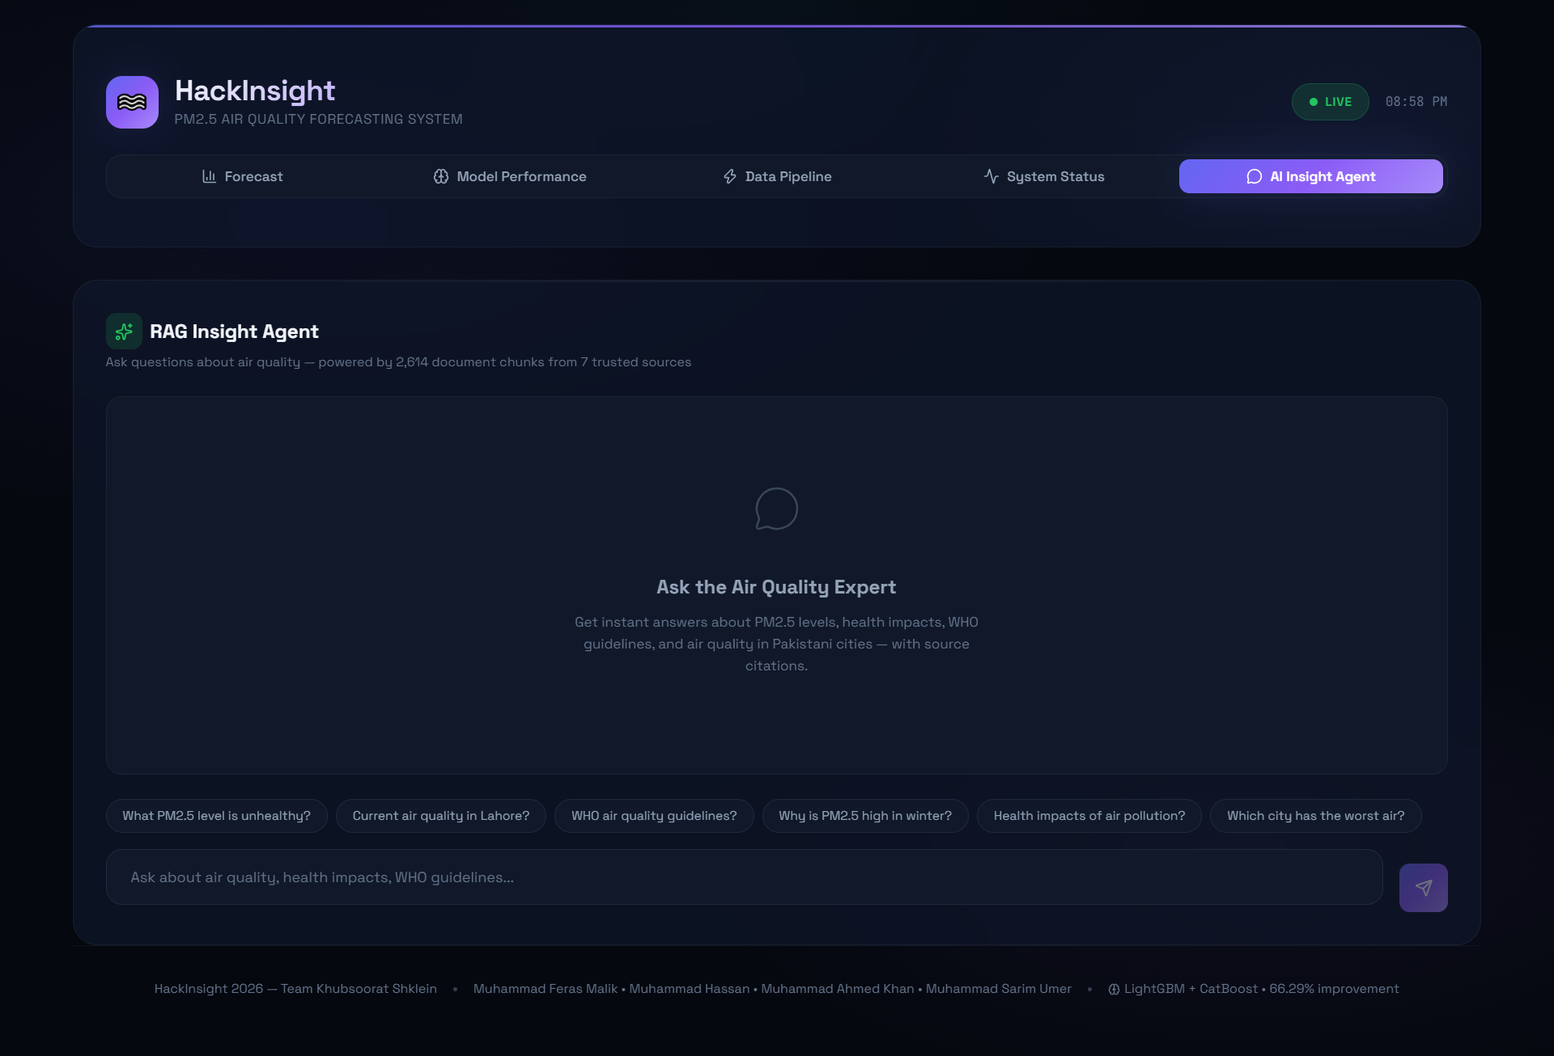
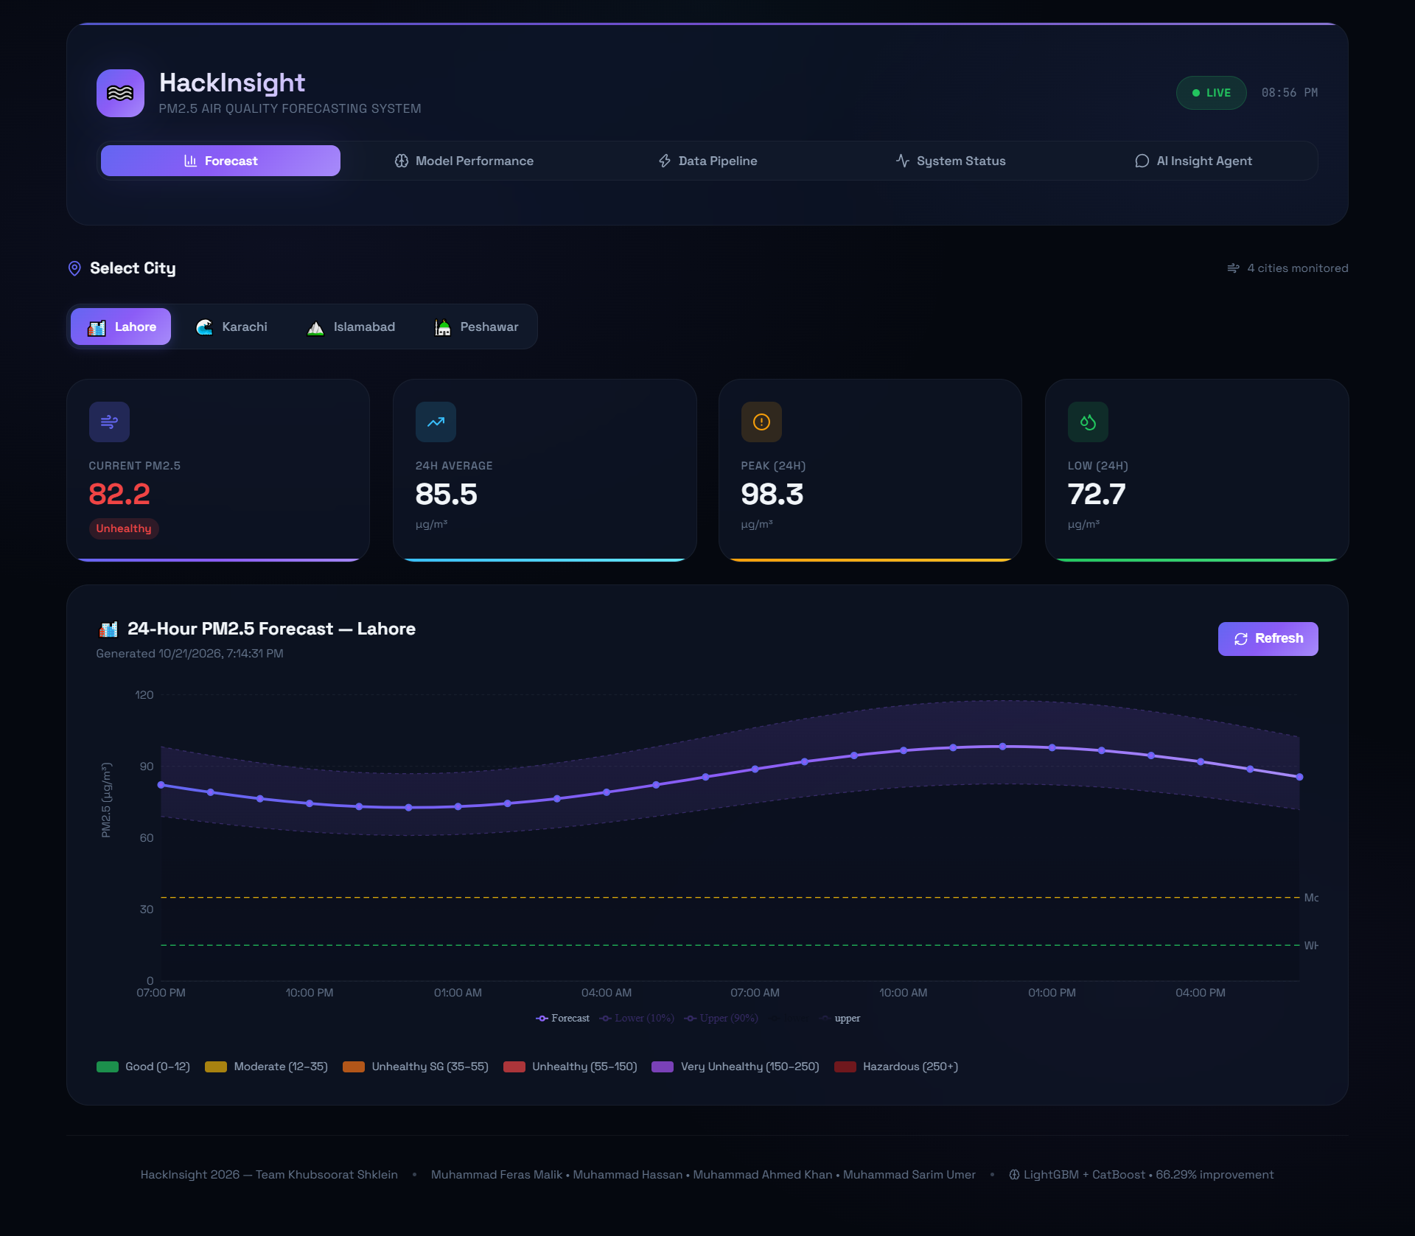
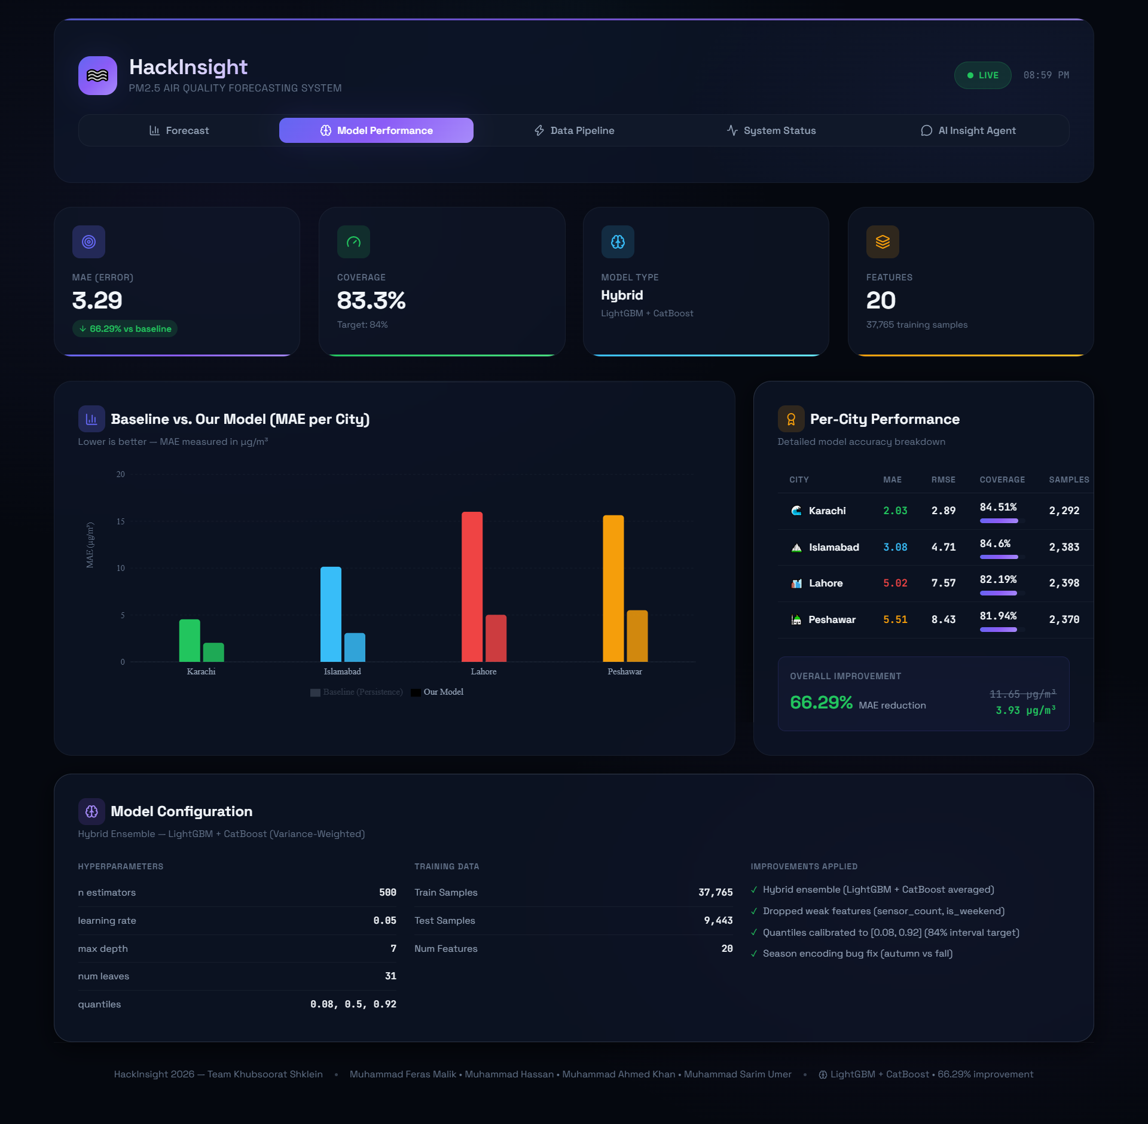
Dashboard / App Views
Page 2: Insight Query
Page 1: Dashboard
Live demo / repo link: https://data-insight-two.vercel.app/
Page 3 – Model Performance

Slide 7
Conclusion
Key finding 1
IMPACT
1
Our model cuts error by 76.1% vs the persistence baseline (MAE 3.93 vs 11.65 µg/m³).
Residents and health officers get early, cited warnings of unhealthy air.
2
Key finding 2
Accuracy varies by city: Karachi is best (MAE [2.30]), Lahore worst (MAE [6.68]) due to winter smog.
FUTURE WORK
Direct multi-step 24h model, more cities, satellite fire data, and cloud DB for live updates
3
Key finding 3
The 80% prediction intervals covered [85.20%]% of test observations on a time-based split.

Slide 8
Team & Credits
Team: Khubsoorat Shklein
MH
MFM
MAH
MSU
Muhammad Hassan
Muhammad Feras Malik
Muhammad Ahmed Khan
Muhammad Sarim Umer
Data Scientist | CT-243]
AI | CT-247
Frontend Developer | CT-245]
Project Manager | CT-235
Github: github.com/Muhammad-Hassan06
Thank you!

